Slide 1
Procedural Map Generation Techniques
Presented by Herbert Wolverson Roguelike Celebration 2020

Slide 2
Who is Herbert Wolverson?
Author of the “Rust Roguelike Tutorial”
Author of upcoming book - Learn Rust: Make 2D Games
Author of Nox Futura and far too many words on r/roguelikedev

Slide 3
Source Code and Slides available at:
https://github.com/thebracket/roguelike-celebration-2020

Slide 4
Introduction
What is Procedural Generation?
How does it fit in with hand-made content?
History of Procedural Generation (more slides)

Slide 5
PART 1 – Basic Generation Techniques

Slide 6
Simple Room-Based Generation
You’ve probably seen this in Roguelike development tutorials.
Simple algorithm:
Start with a solid map.
Randomly select a room area.
If the room is solid, carve it out and store it in the “rooms” list.
Repeat until you have enough rooms.
Iterate your rooms list, and add dog-leg corridors.

Slide 7
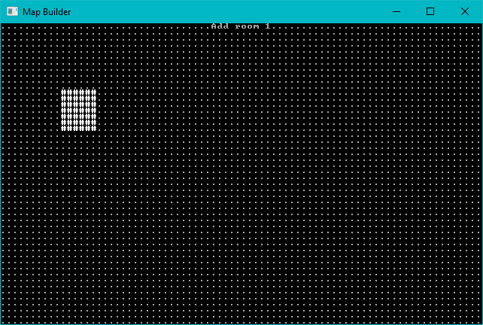
Start with a solid map, add one room at random.

Slide 8
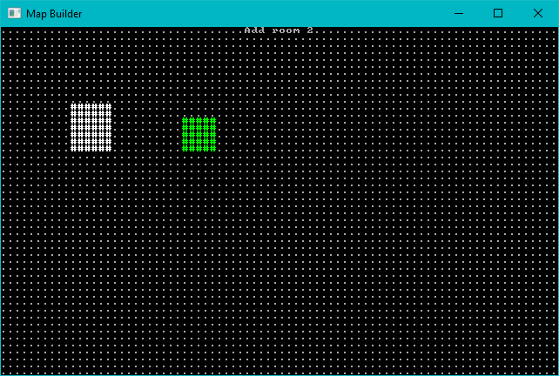
Add a second room

Slide 9
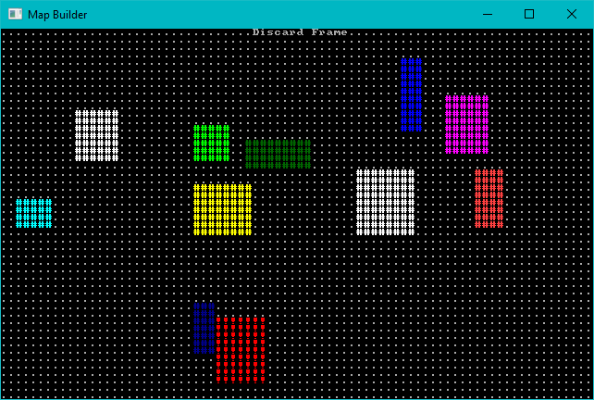
Keep Adding Rooms – Don’t Add Overlapping Ones

Slide 10
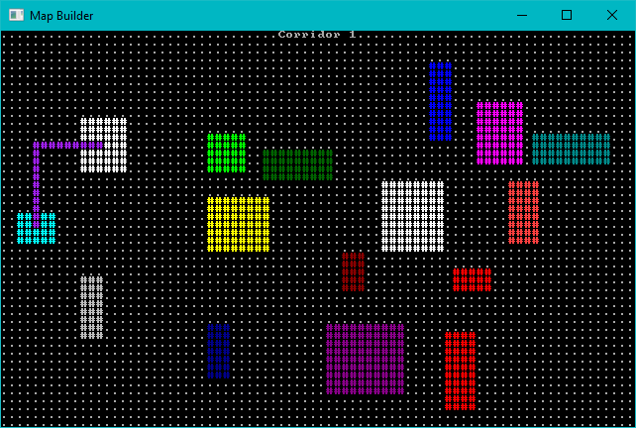
Add Corridors – Dog-leg Style

Slide 11
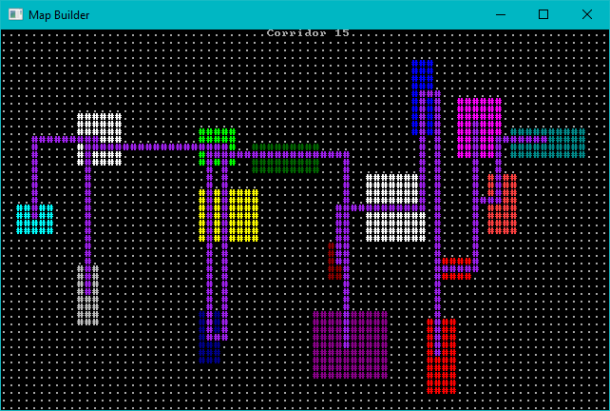
Add More Corridors Until Every Room is Connected

Slide 12
Room Algorithm - Animated

Slide 13
Sub-Divide Room-Based Generation
Nicer room generation. Nethack uses it. (In BSP form)
Divide your map into squares – and divide those squares into squares.
Each sub-square might become a room.
Sort rooms and add corridors.

Slide 14
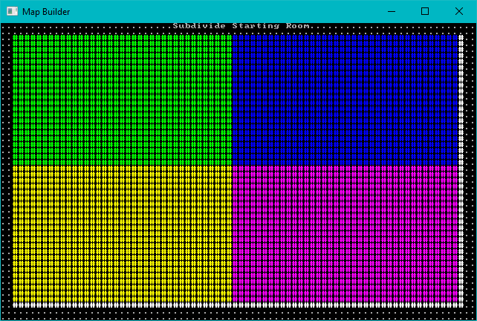
Subdivide the map

Slide 15
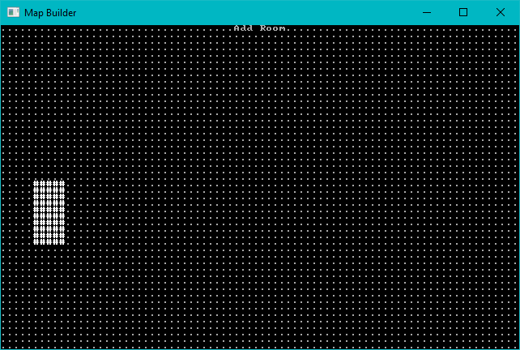
Consider each region. Either divide, or add a room.

Slide 16
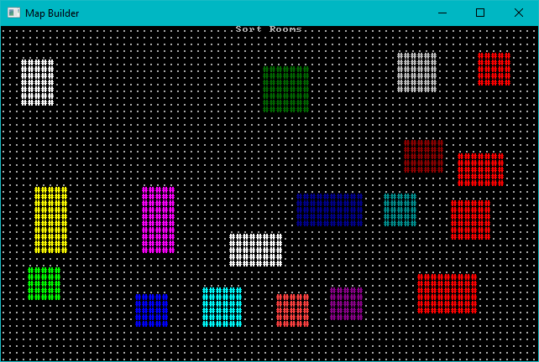
Keep Adding Rooms, Sort by X

Slide 17
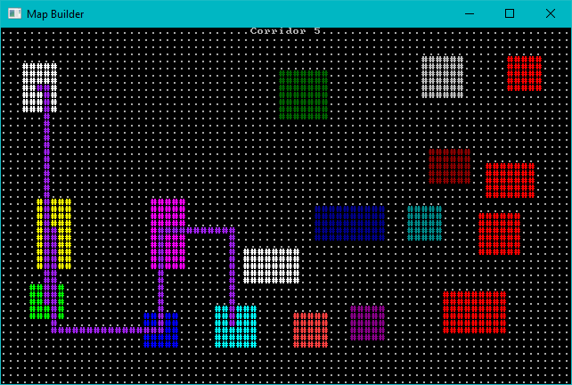
Add Corridors as Before

Slide 18
Animated Sub-Division

Slide 19
Cellular Automata
Evolve order from chaos.
Treat each cell as its own entity, make “live” (become a floor) or “die” (become a wall) decisions by counting neighbors.
Great for organic, natural looking maps.

Slide 20
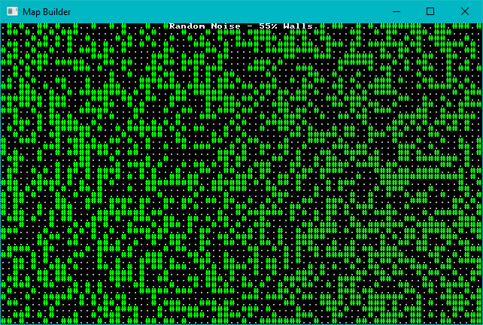
Start with Some Chaos (55% walls)

Slide 21
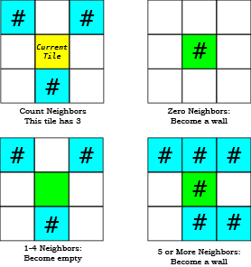
For each tile, count neighbors and decide on its future.

Slide 22
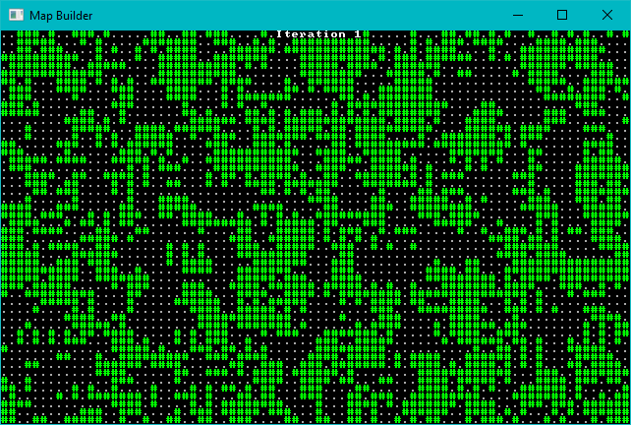
Let each iteration run

Slide 23
Animated Cellular Automata

Slide 24
Drunkard’s Walk
Give an Umber Hulk an unlimited pot of beer, and see what happens.
Starts with a solid level.
Place a digger, and have them stagger randomly clearing tiles.
Find an open tile, and start a new digger there.
Repeat until you have a sufficiently open map.

Slide 25
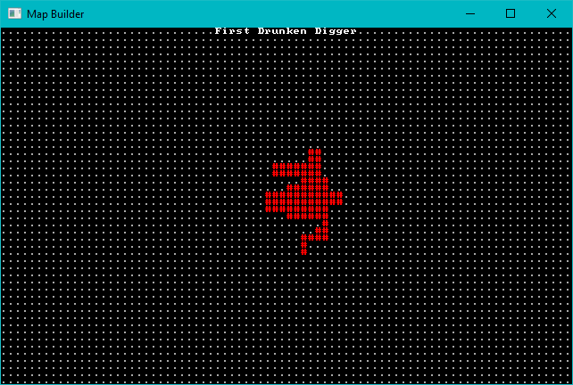
First Random Digger

Slide 26
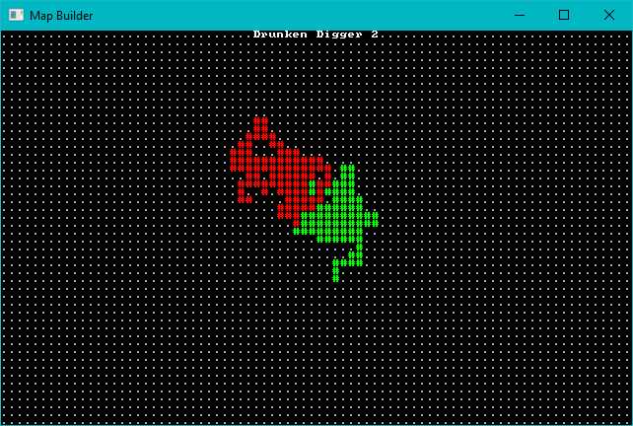
Second Random Digger

Slide 27
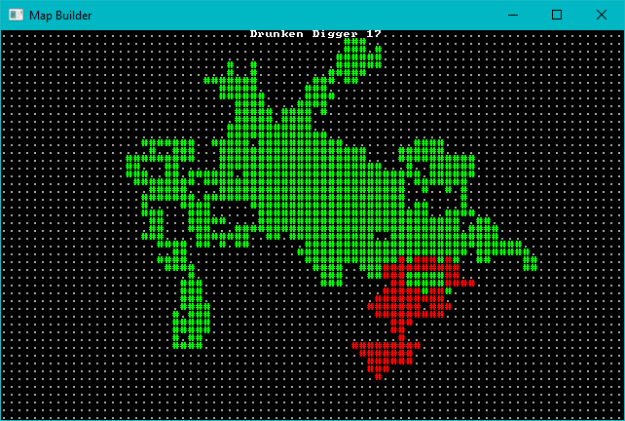
Keep Digging

Slide 28
Animated Drunkard’s Walk

Slide 29
Diffusion Limited Aggregation

Slide 30
DLA Progression

Slide 31
Voronoi Hive Maps

Slide 32
PART 2 – Mix It Up a Bit

Slide 33
Symmetry

Slide 34
Brushes

Slide 35
Corridor Algorithms

Slide 36
Erosion

Slide 37
Doors

Slide 38
Waveform Collapse

Slide 39
PART 3 – Combining Effects

Slide 40
PART 5 – Prefabs/Vaults

Slide 41
Noise

Slide 42
Wrap-Up

Slide 43
Questions?

